Slide 1

Student Details
Name : kunapareddy.divyasaisri
SKILL BUILD E-MAIL ID : kunapareddydivyasaisri@gmail.com
College nAME : RAMACHANDRA COLLEGE OF ENGINEERING
COLLEGE STATE : Andhra pradesh
Internship domain : Cyber security
Internship start date : 03.06.2024
Internship end date : 15.07.2024

Slide 2

Hiding a text inside an image using steganography
In an era of digital espionage and data breaches, traditional encryption methods can be inadequate. Steganography provides a transformative solution by embedding messages in plain sight, thus enhancing the confidentiality of sensitive information.

Slide 3
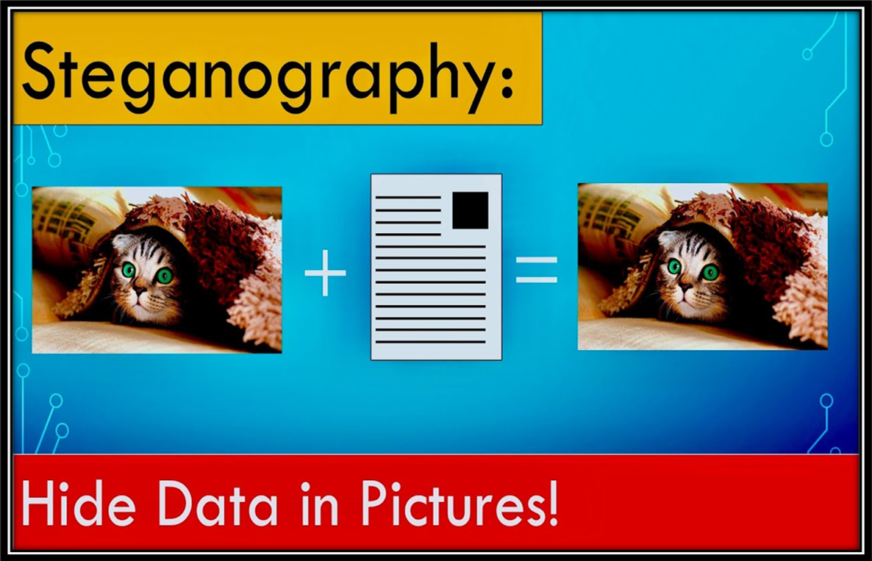
AGENDA
Introduction to Steganography
Project overview
Target End Users
Solution and Value Proposition
Customization and Personalization
Technical Modelling
Results and Achievements
Links and Resources

Slide 4
PROJECT OVERVIEW
Purpose of the Project:
The primary purpose of this project is to explore and implement a method for securely hiding text within an image using steganography.
This technique aims to protect sensitive information from unauthorized access by concealing its existence within seemingly harmless images.
Objectives:
Create a tool that can embed and extract text from image files using the Least Significant Bit (LSB) method.
Integrate encryption to enhance the security of the hidden text.
Implement techniques to minimize the impact on image quality while embedding the text.
Scope of the Project :
Implement the LSB steganography algorithm for embedding text in images.
Develop encryption and decryption functionalities to secure the hidden text

Slide 5

WHO ARE THE END USERS of this project?
The primary end users for this steganography project include government and military personnel secure communication, corporate executives protecting proprietary data, and journalists sharing sensitive information discreetly.
IT and cyber security teams can integrate this technique to enhance organizational data security.
Additionally, the person who wants to send any secret message other person in a hidden format then this project will helpful for them.

Slide 6
YOUR SOLUTION AND ITS VALUE PROPOSITION
Steganography is the basic concept to hide the data inside other data.
In this project RGB Mechanism is used for pixel manipulation.
XOR operation is used for encryption and decryption of the test inside the image.
The project reads an image and hides the secret text within the pixel values using the least significant bits (LSB) method.
For security purpose that means to avoid unauthorized users taking the advantage of the message, a secret key used to hide and unhide the data.
Finally, By using this project we can hide the data inside an image using secret key and for unhide the message secret is used.

Slide 7
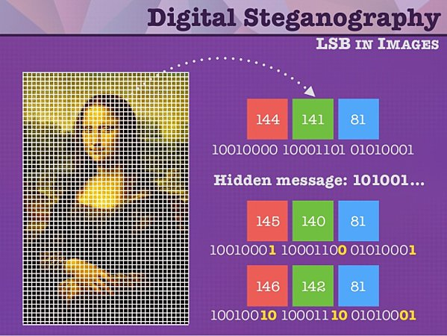
How did you customize the project and make it your own
By using problem statement this project is created to hide a text inside an image using RGB, LSB method is used for imperceptible to the human eye. And here XOR operation is used for hide and unhide the image.
This project is customized only to hide a text inside an image using above conditions and can only unhide the image who has secret key others are not able to unhide the image.

Slide 8
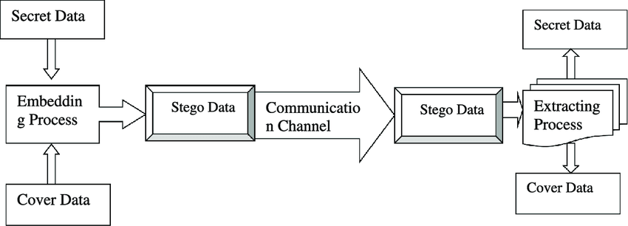
MODELLING
Step 1: importing some libraries like cv2 and os for accessing relevant concept into code.
Step 2: After converting the text into their ascii values then that ascii values are stored in variable.
Step 3: Read the image from it’s path and hiding the image using XOR operation , RGB mechanism
Step 4: A secret is created to avoid unauthorized users.
Step 5: To unhide the image user wants to enter the secret key.
Step 6: Finally, user can able to see the secret message.

Slide 9
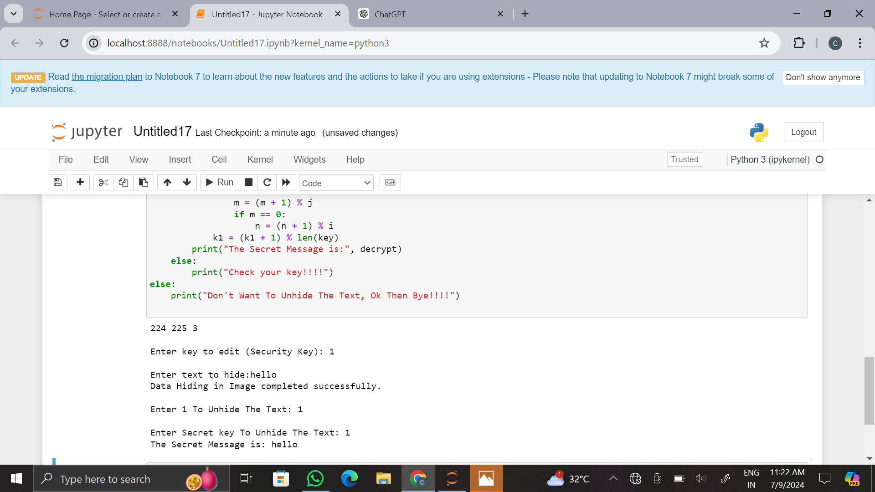
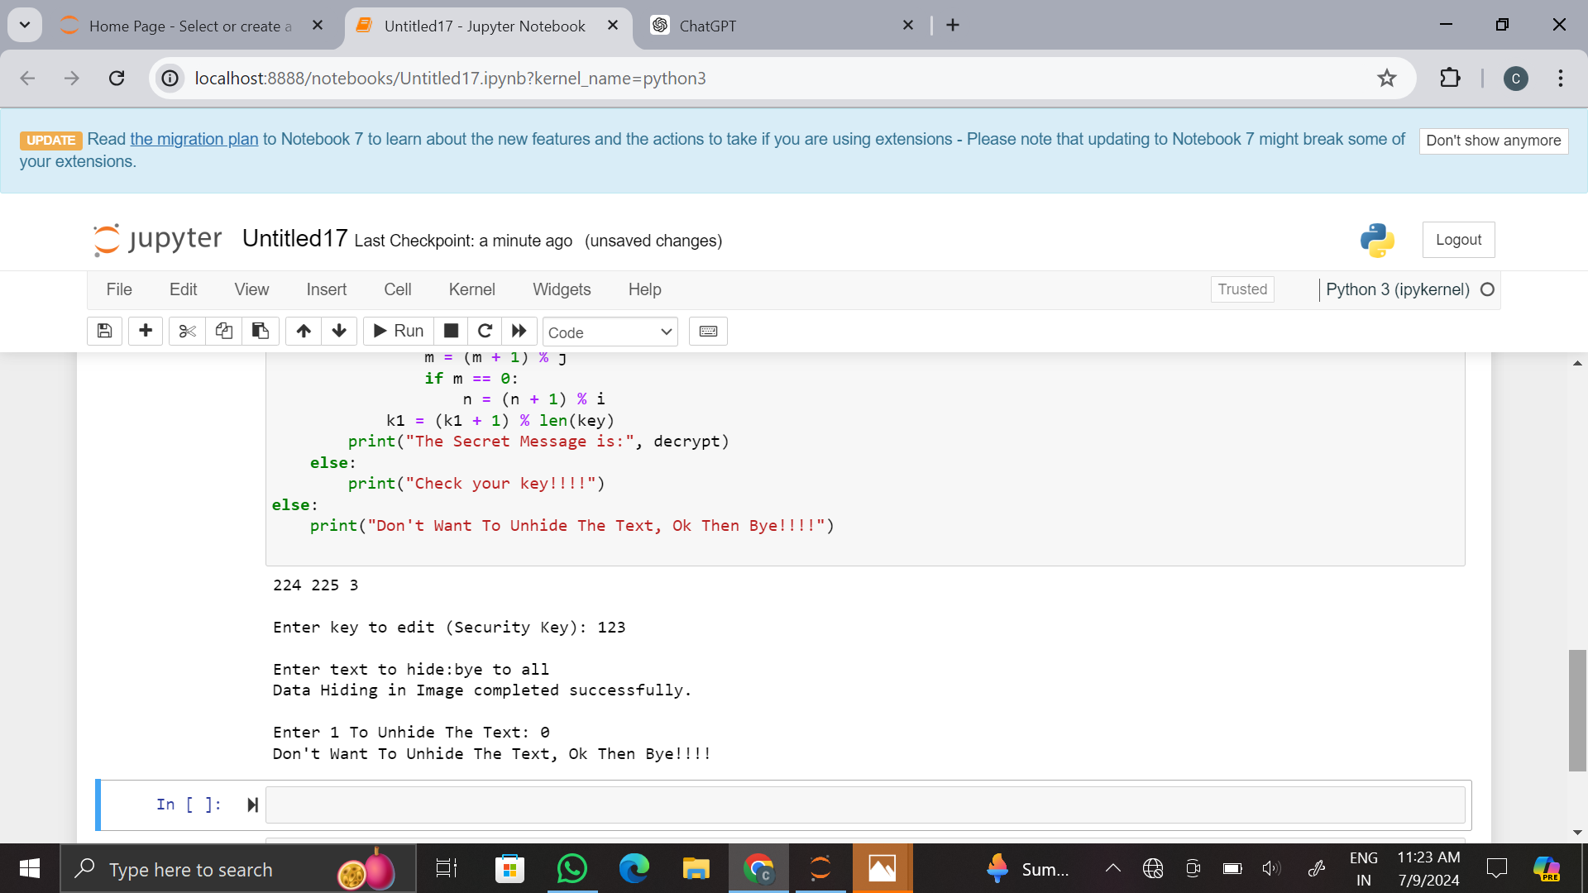
Results

Slide 10


Original image
Encrypted image

Slide 11
links
https://github.com/kdiv286/K.-Divya-sai-sri.git

